Slide 1


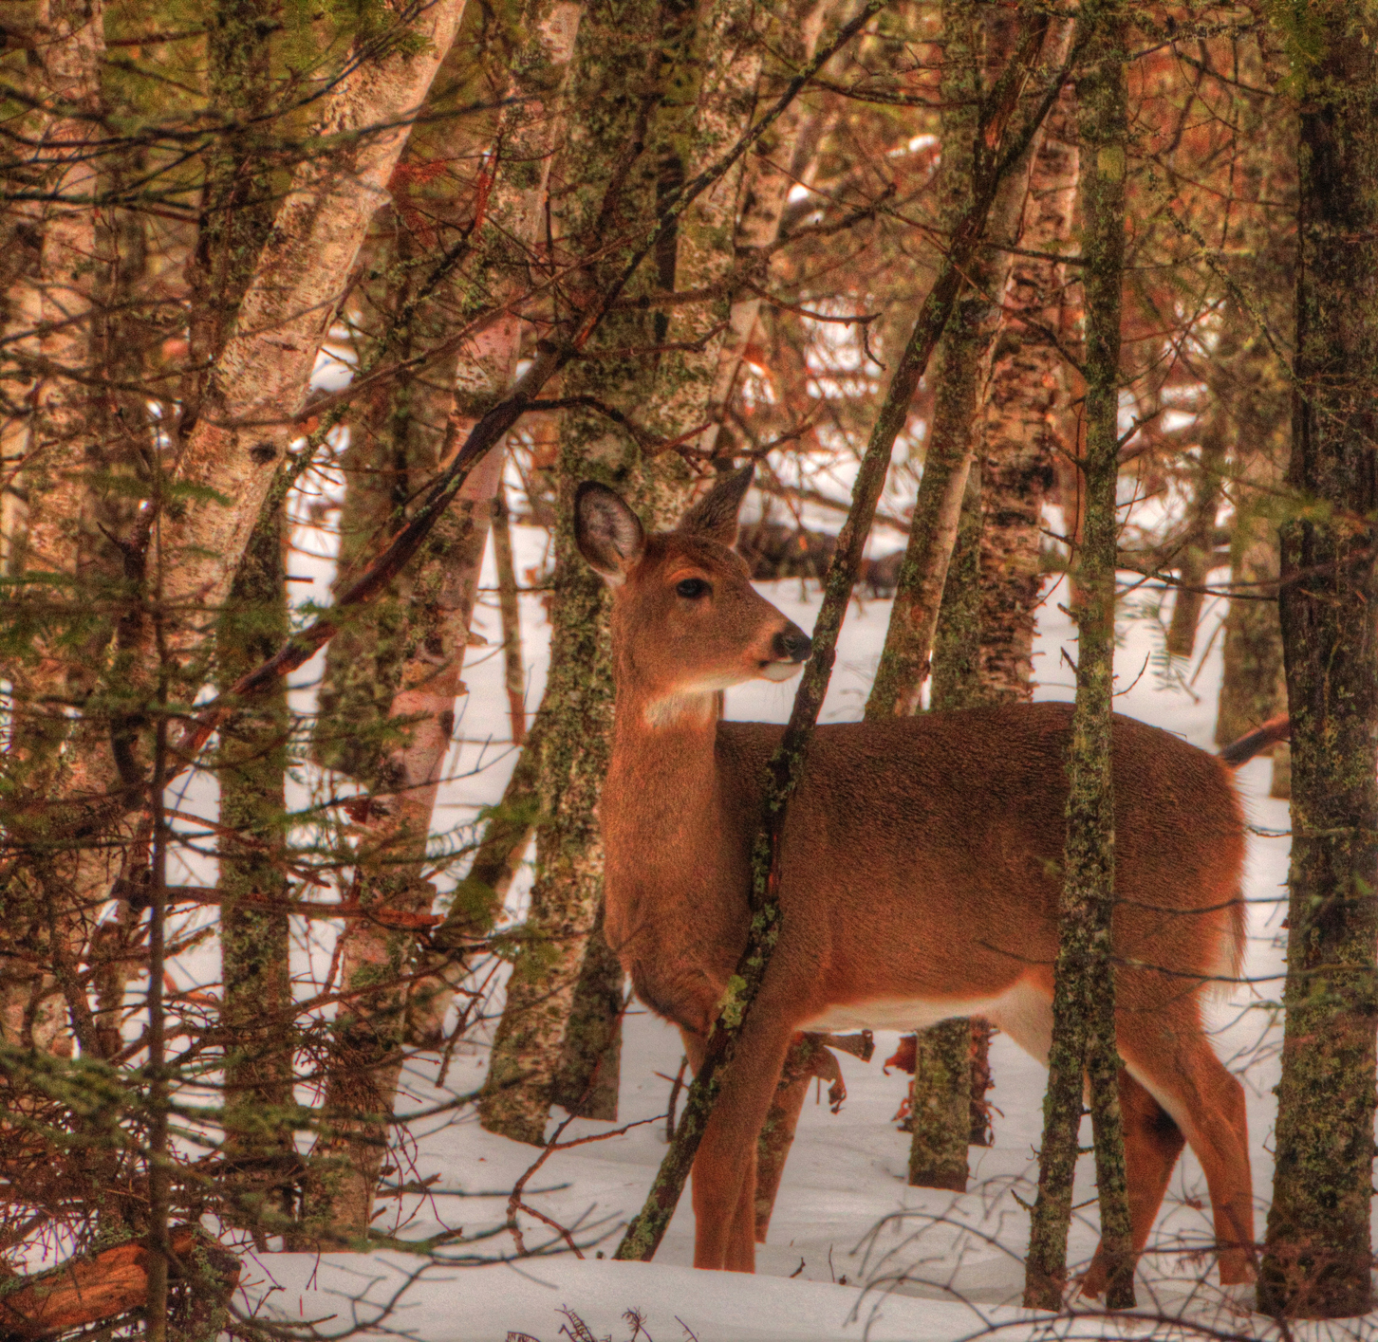
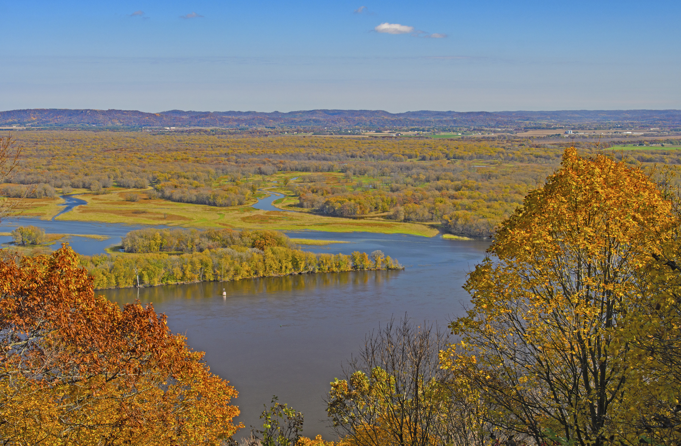
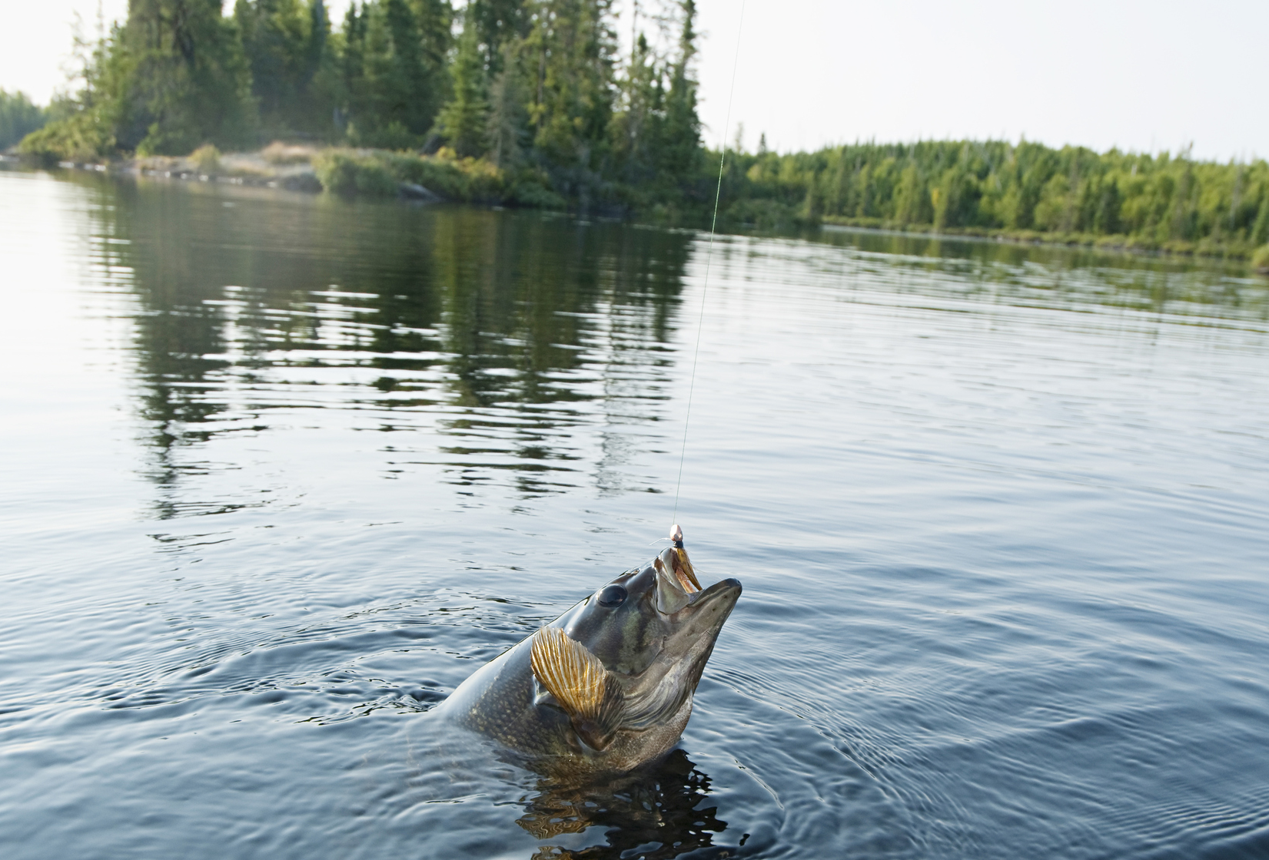
PRESENTATION
LESSARD-SAMS
OUTDOOR HERITAGE COUNCIL
11.21.19

Slide 2
Project goals
• • • •
Share accurate, targeted and timely information about the fund and program accomplishments
Create and implement tools and templates for staff and program managers to report accomplishments
Make new connections with partners; create new fans; spread good news
Monitor and report success of outreach efforts

Slide 3
Target markets
• • • •
Project partners
Conservation and outdoor groups
Media / influencers
Minnesotans

Slide 4
Tactics
• • • •
Targeted media outreach
Increase website traffic
Social media
Public relations
Creative assets
Connections and relationship building

Slide 5
Creative

Slide 6

Overview
• • • •

Slide 7

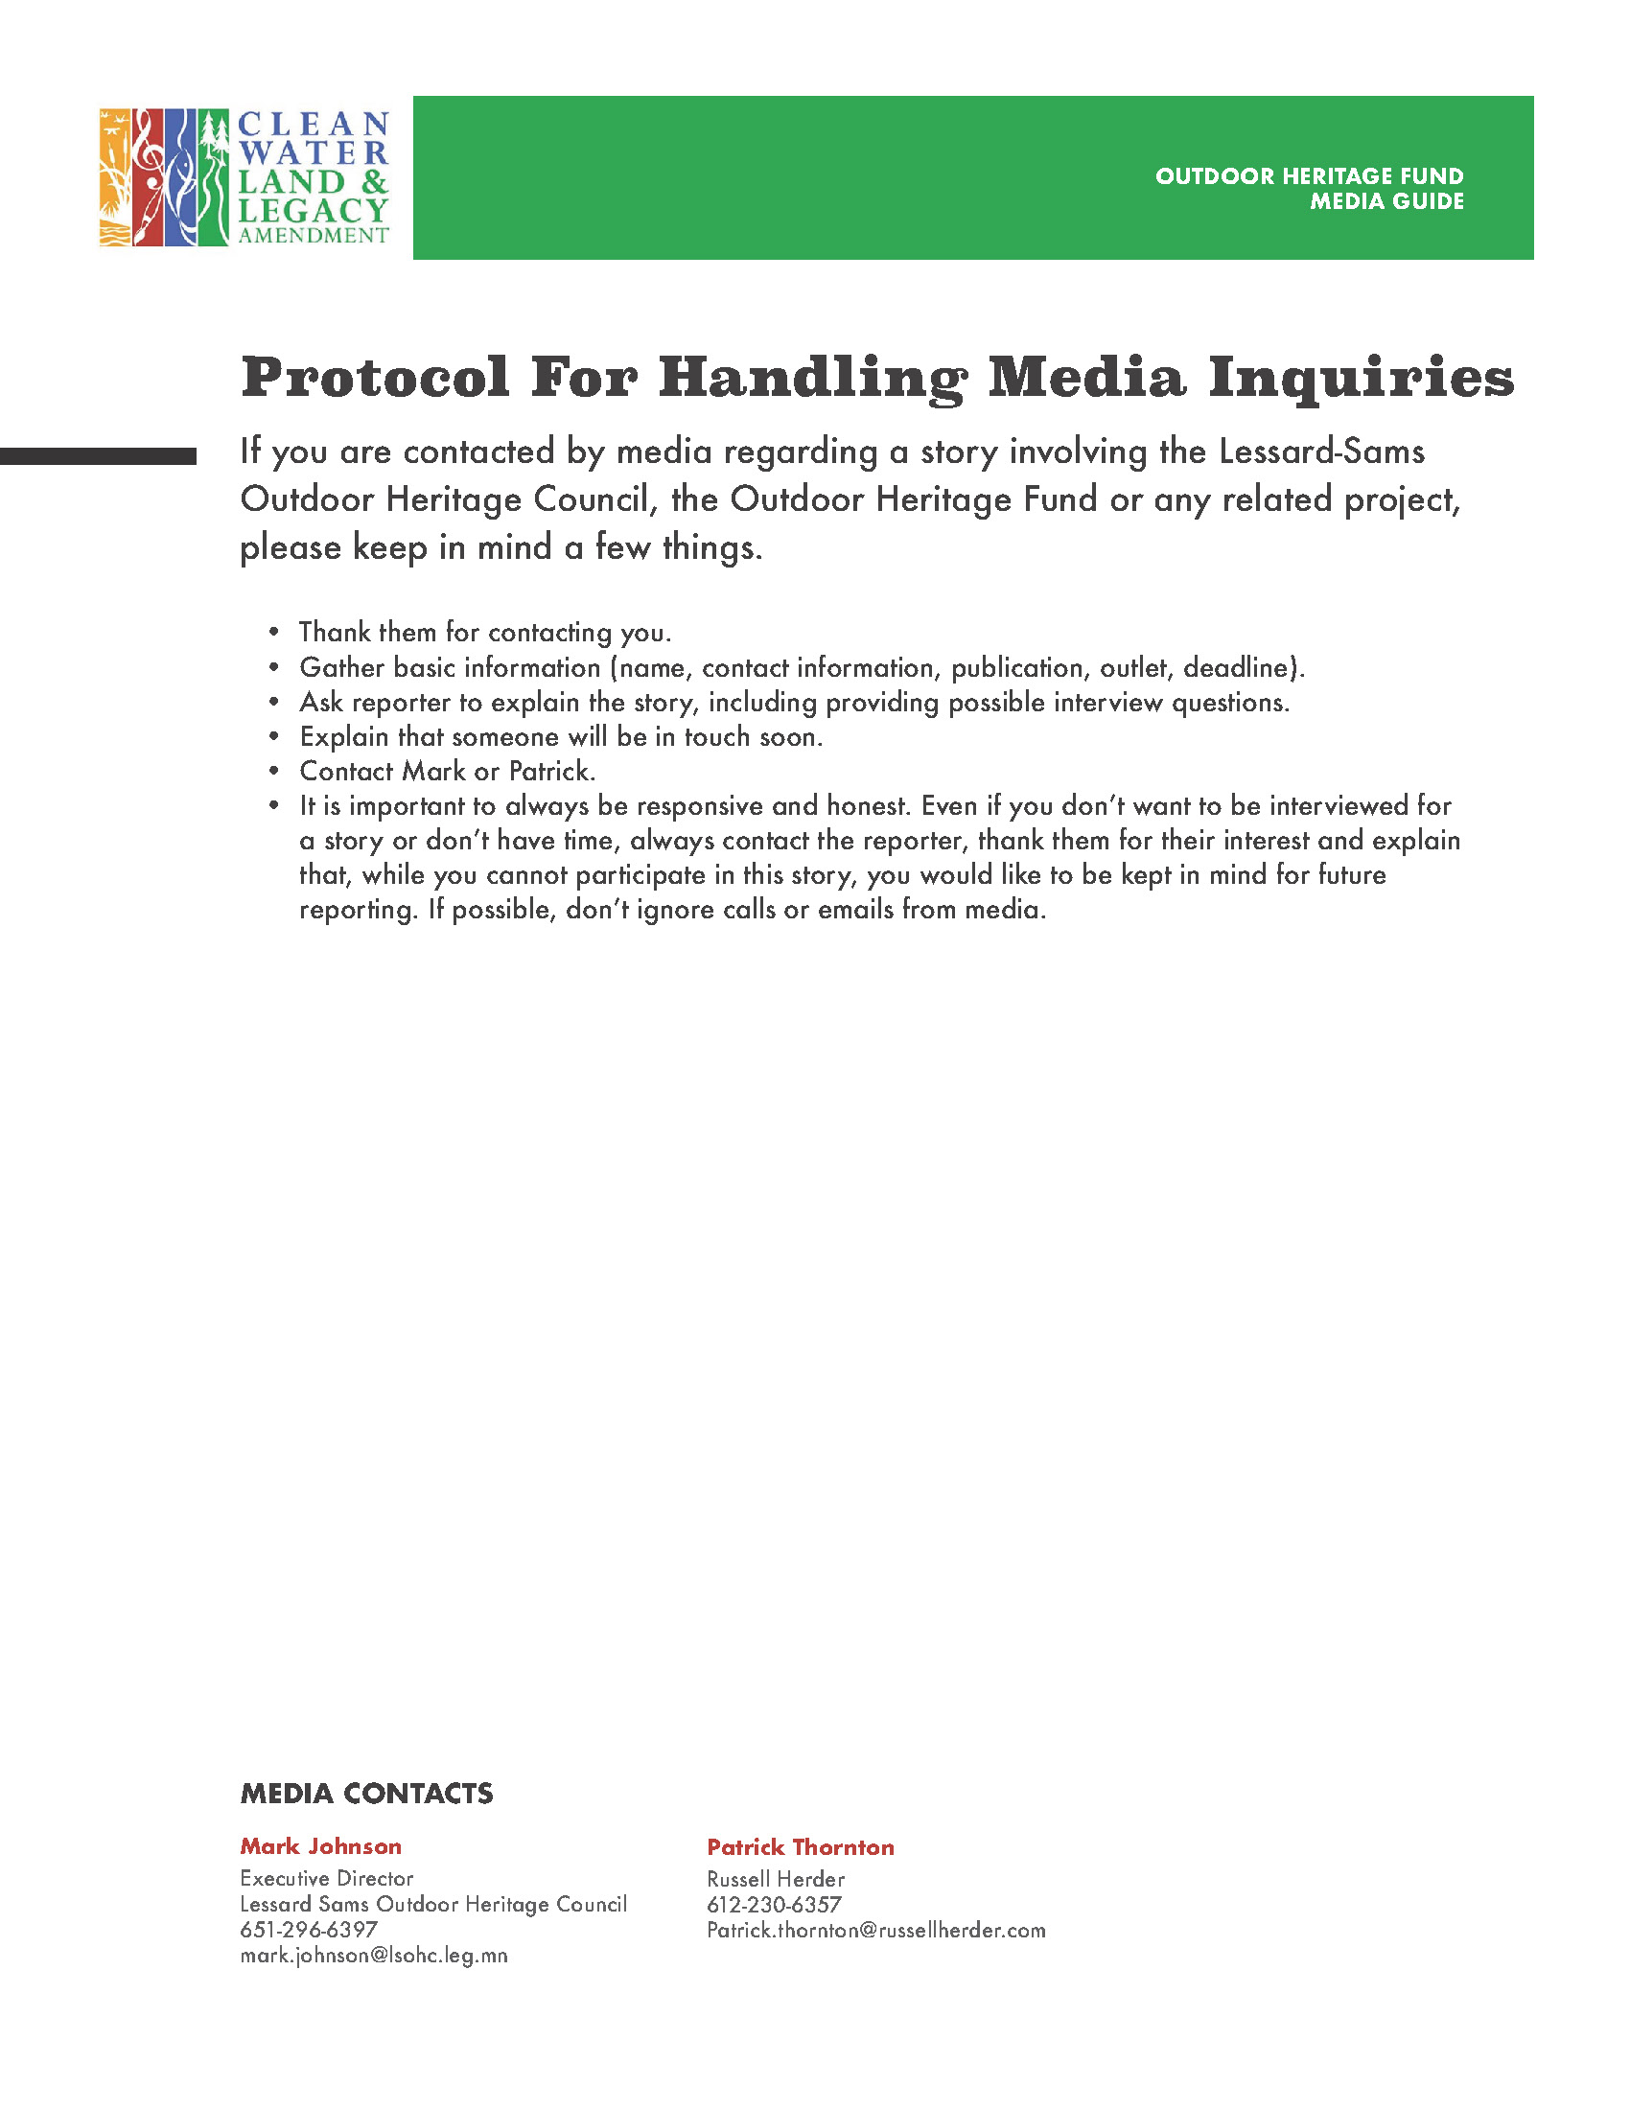
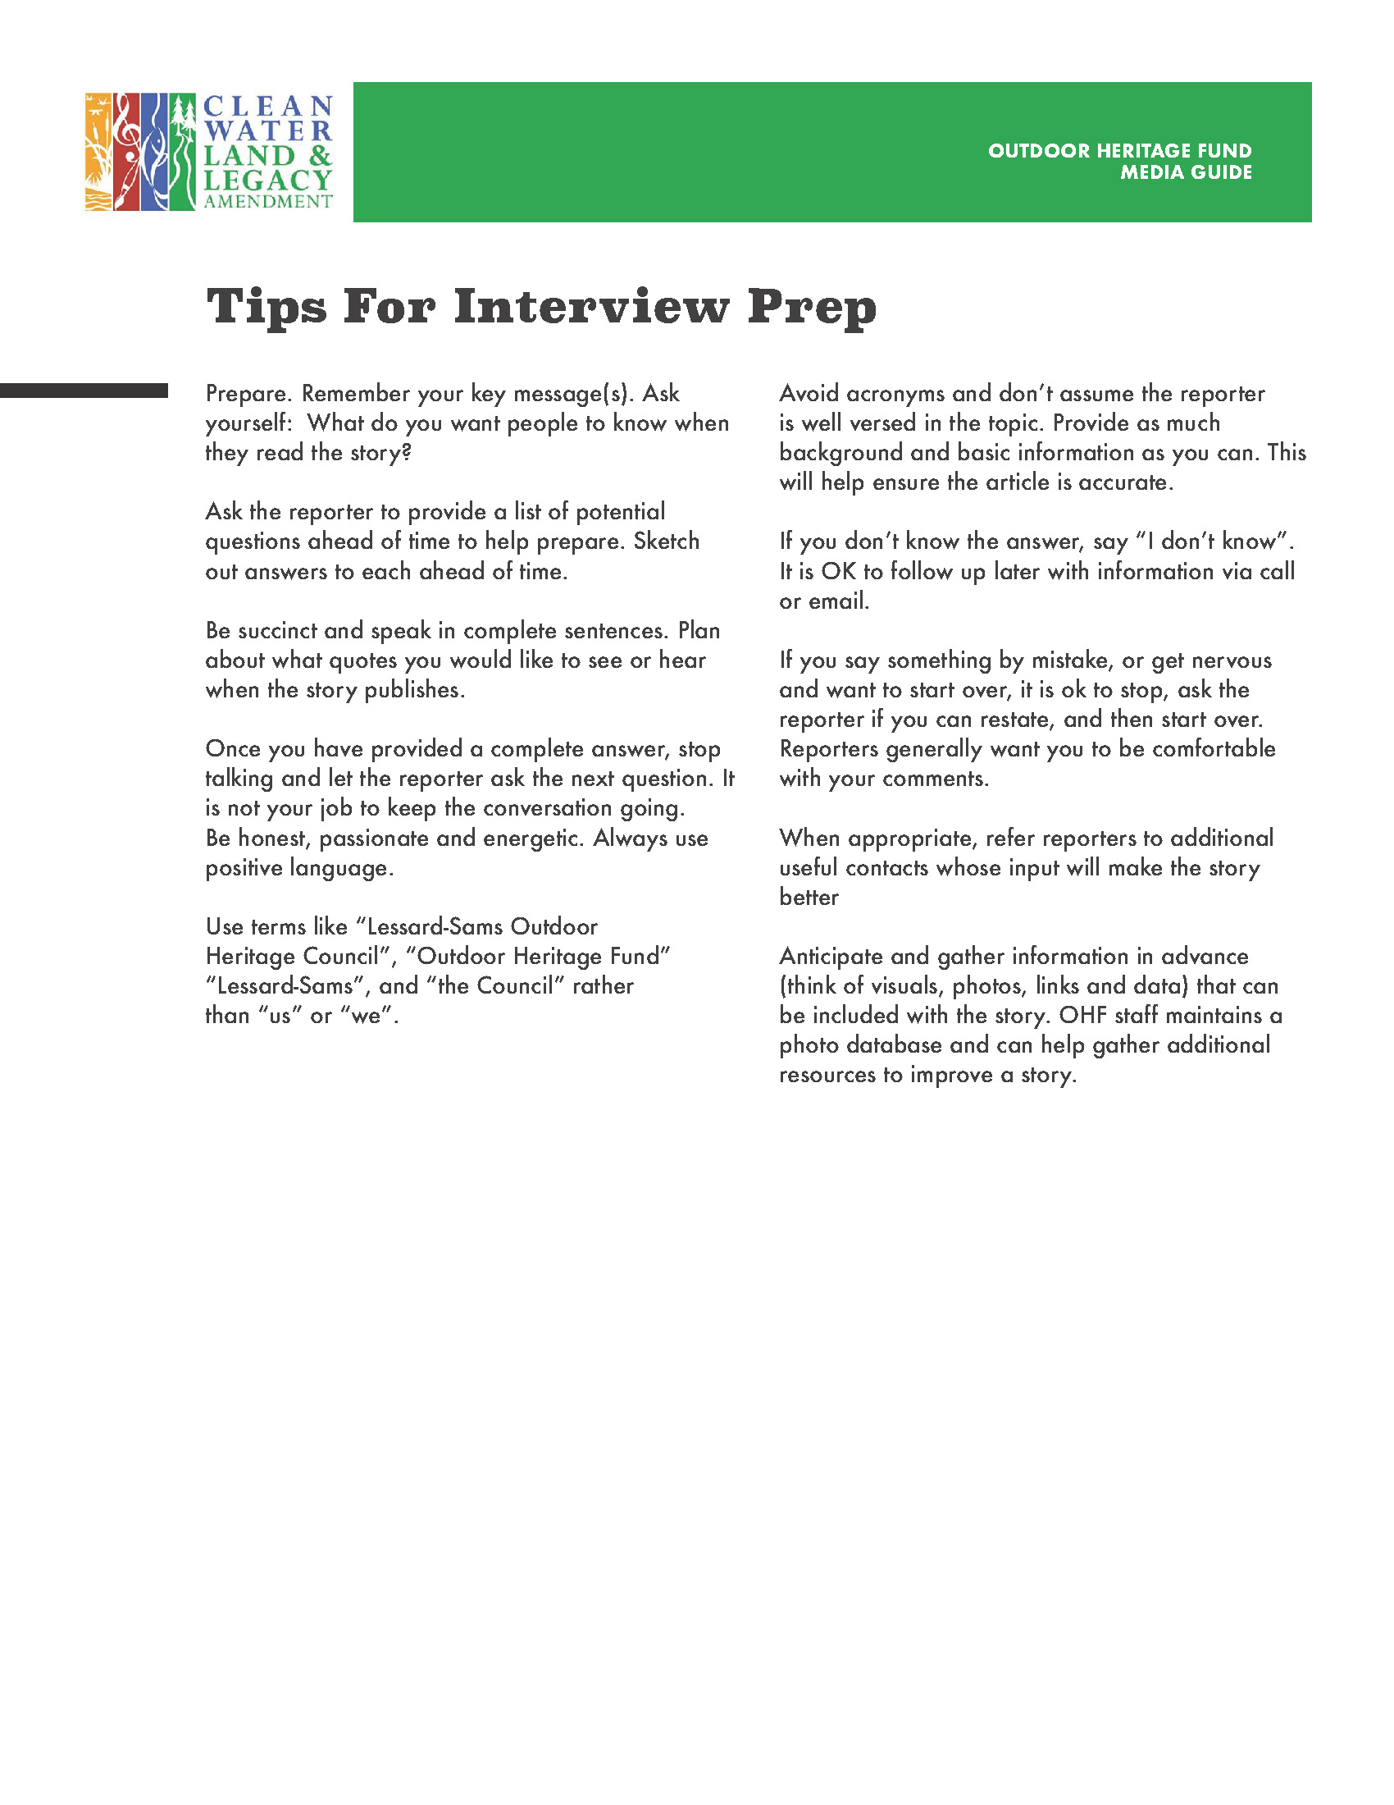
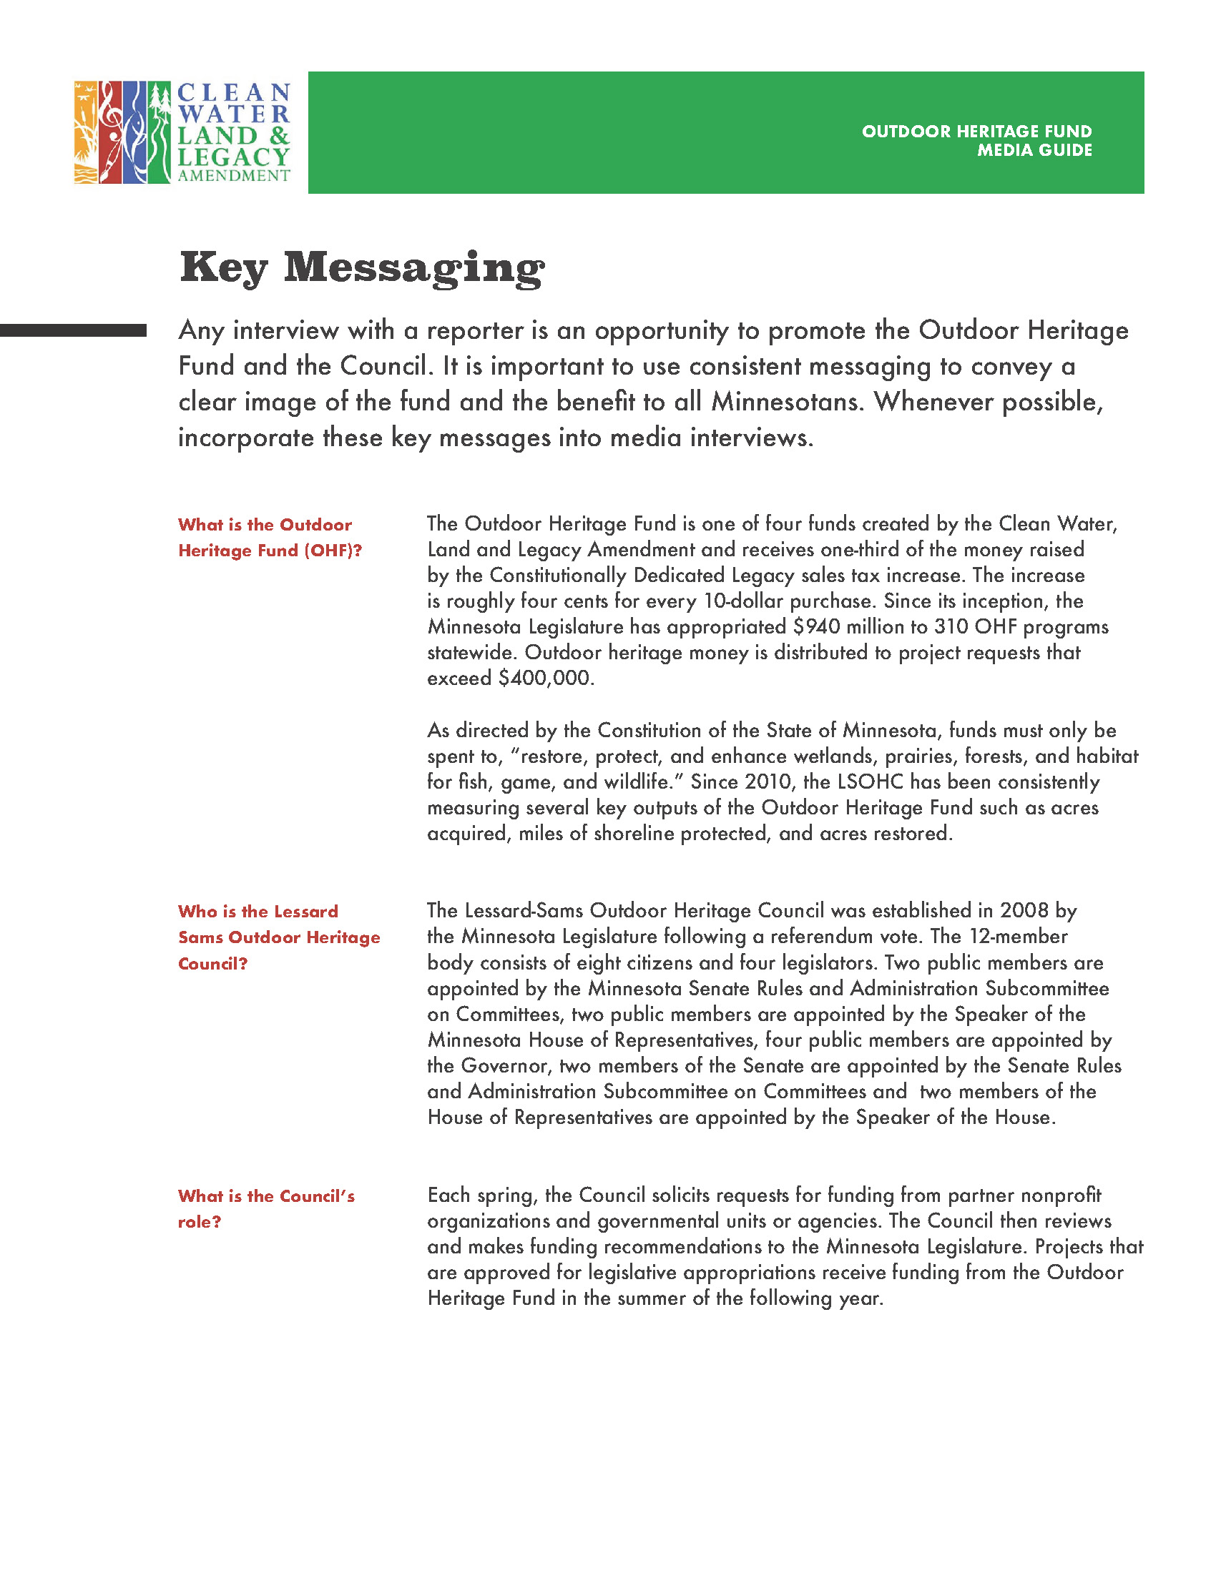
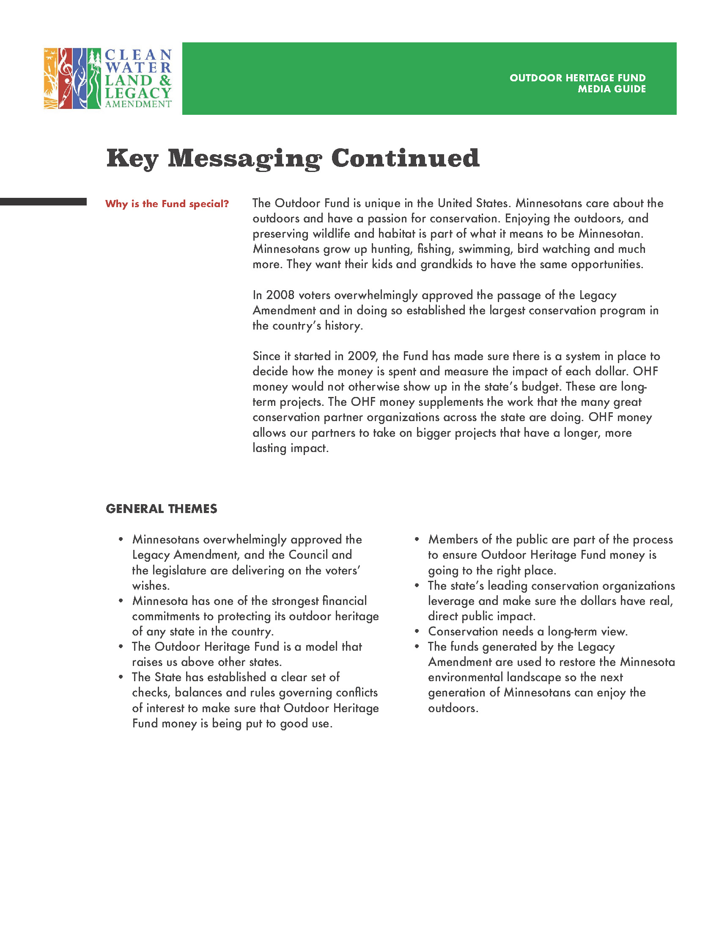
Media
guide
• • • •

Slide 8
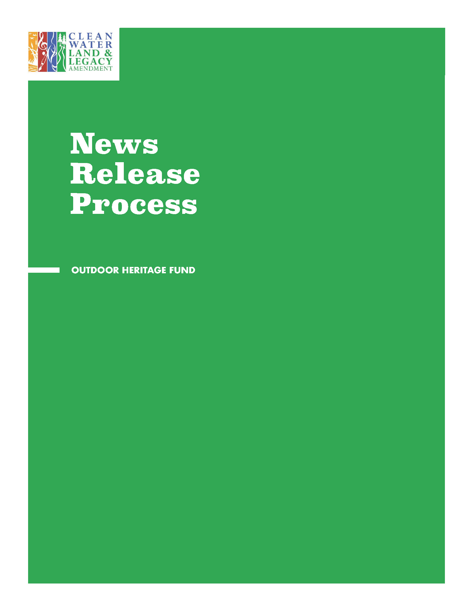
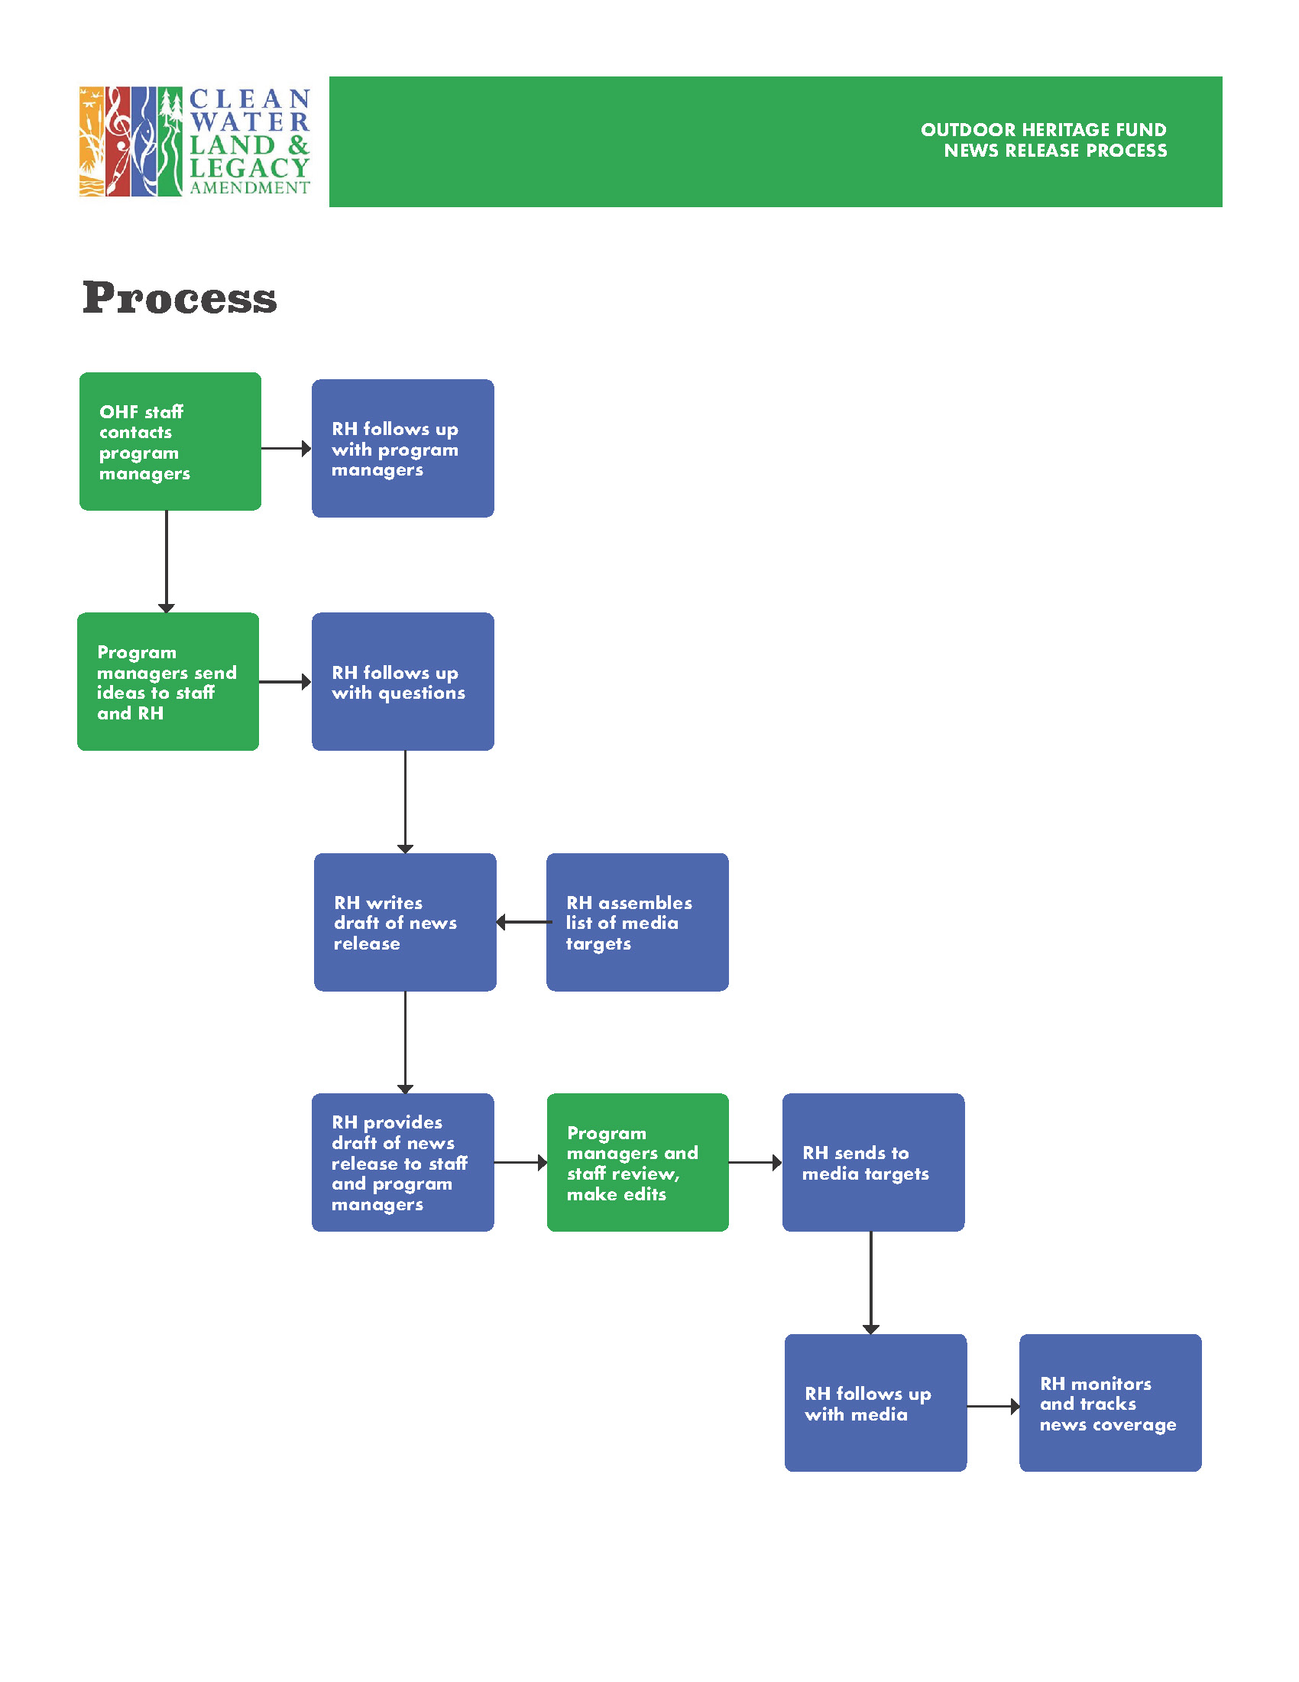
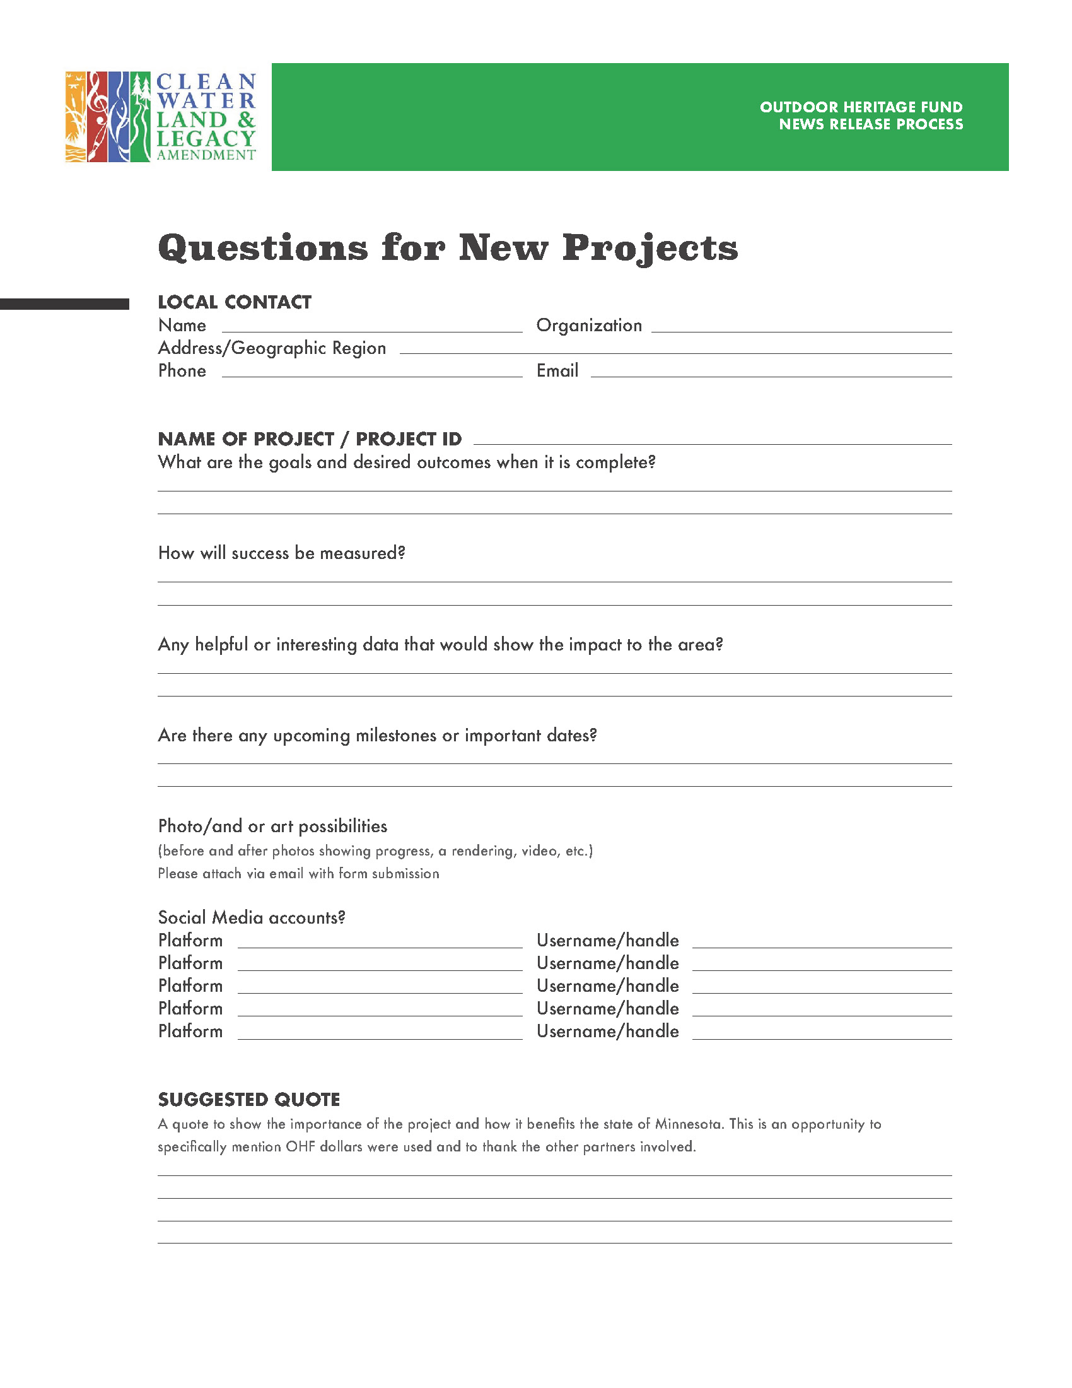
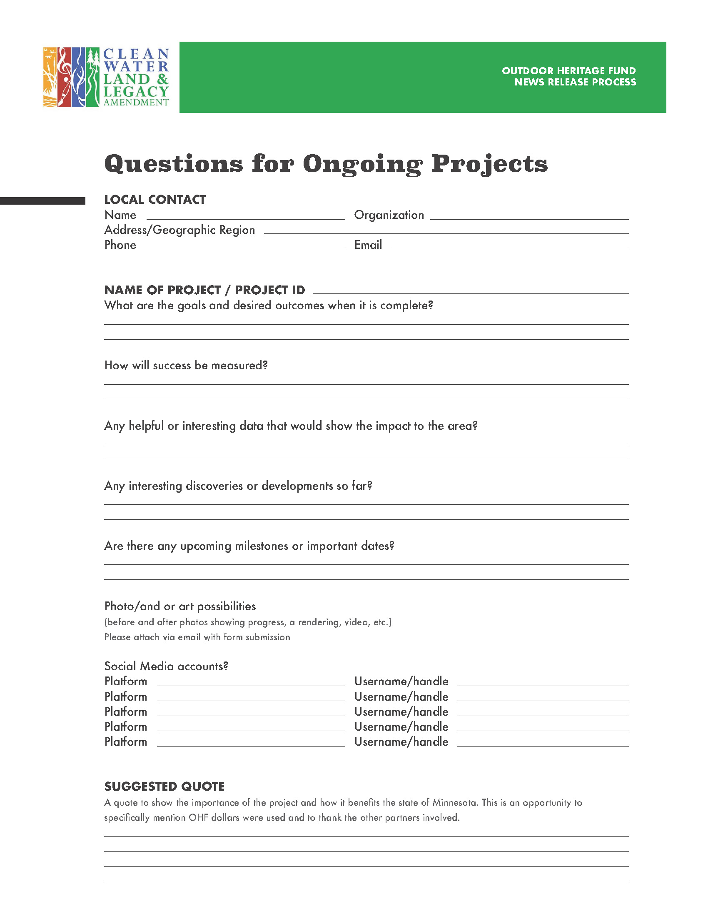
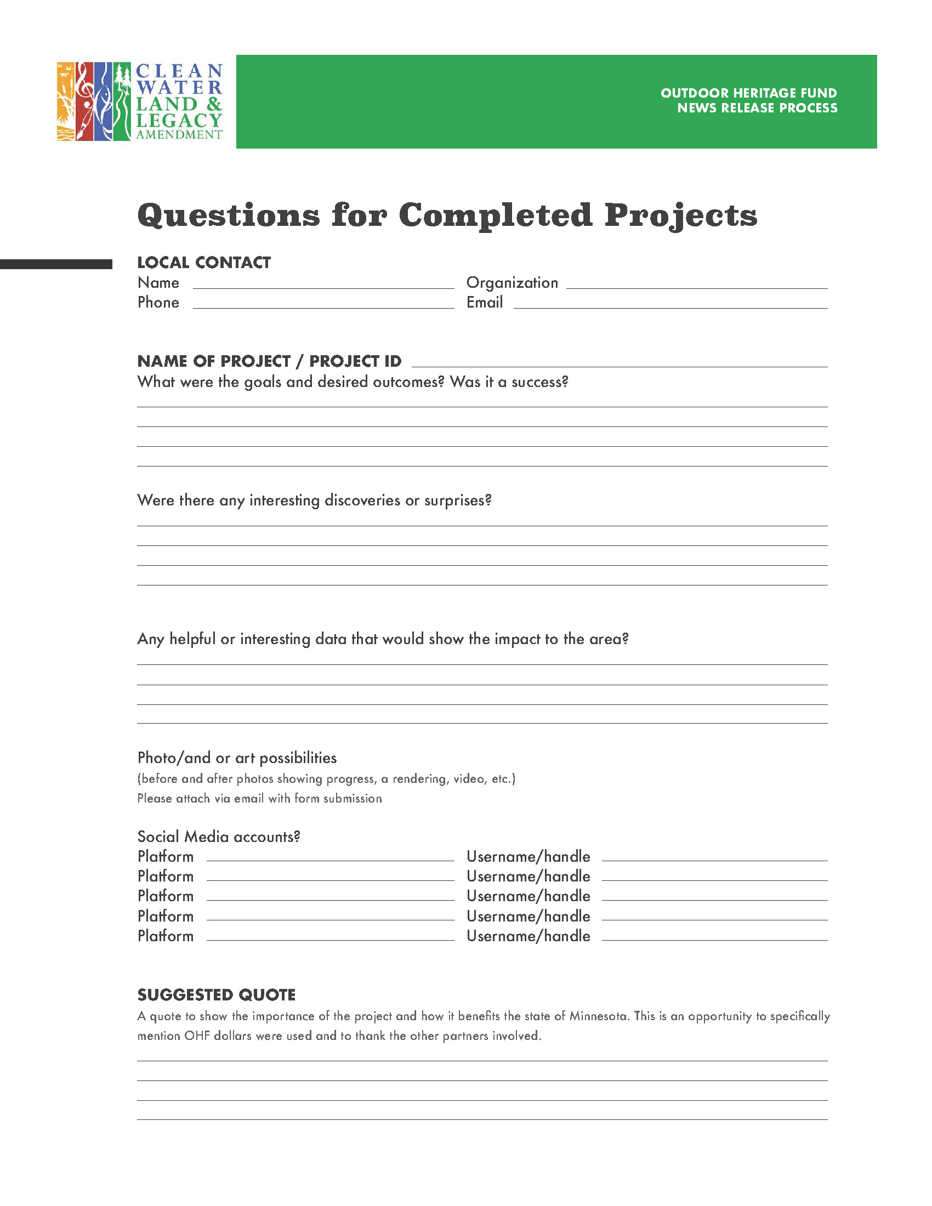
Outreach
guide
• • • •

Slide 9
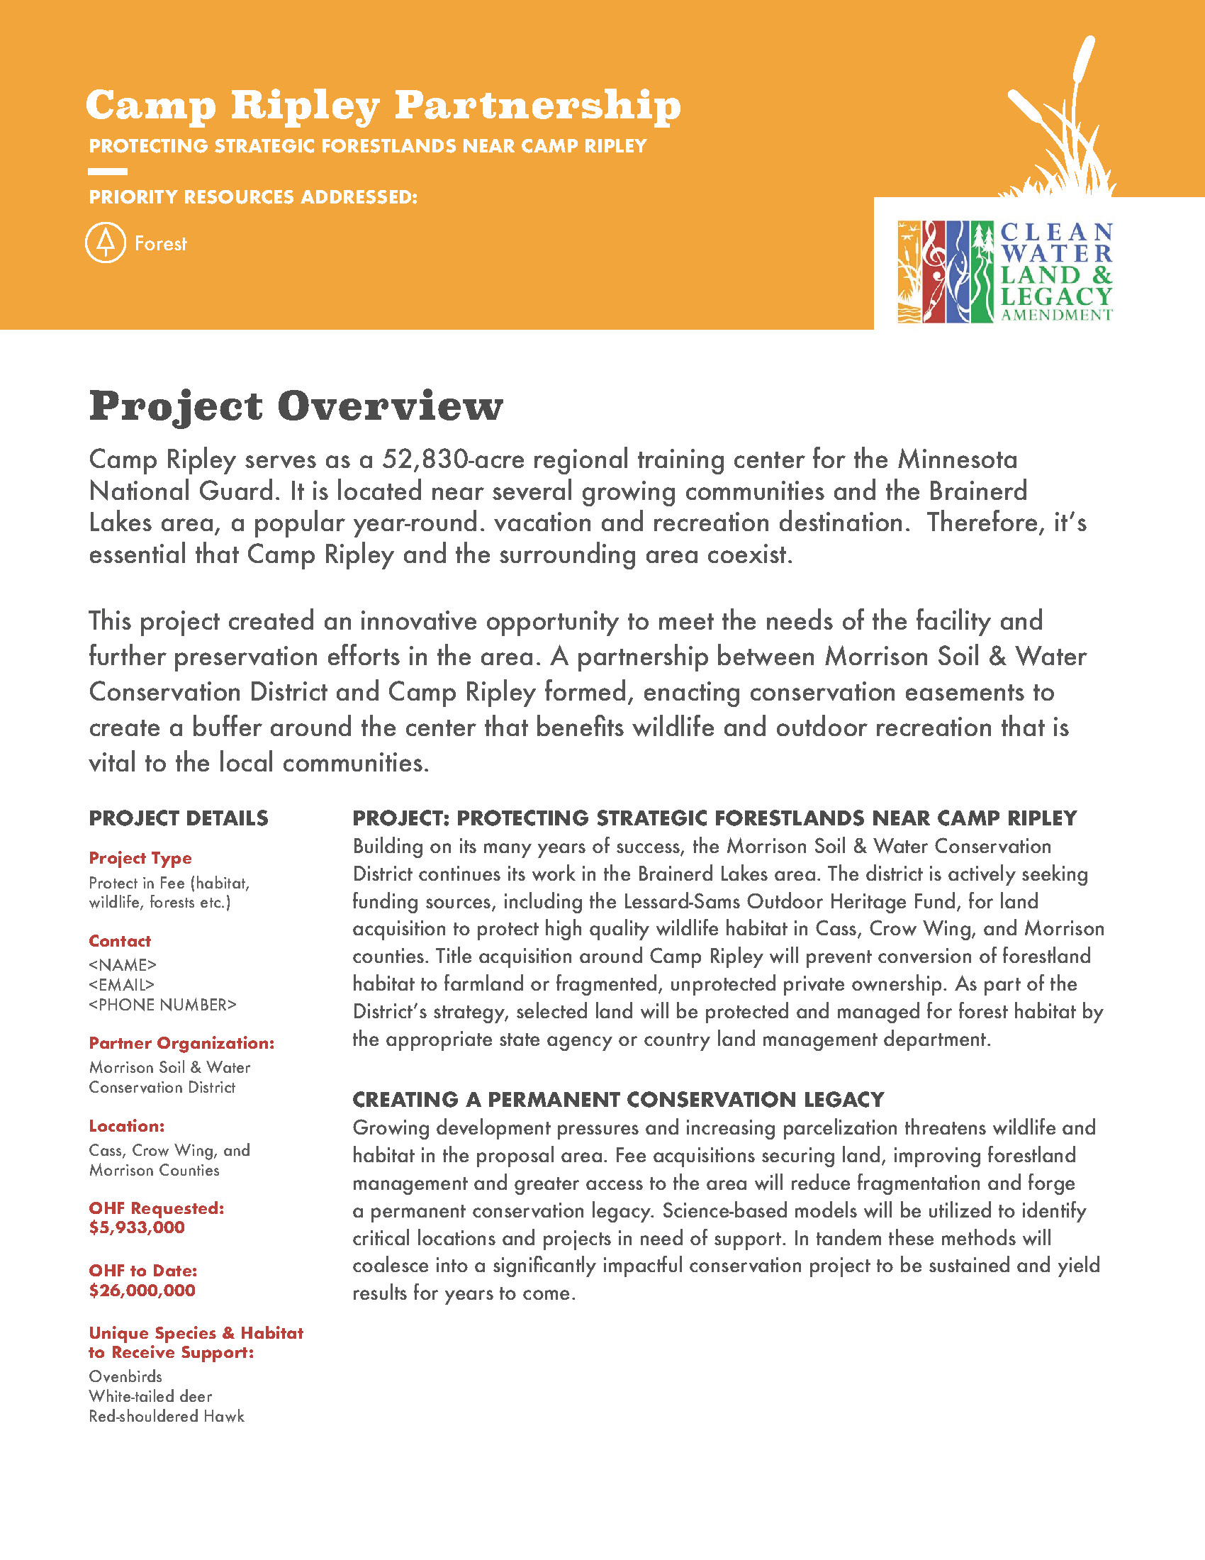
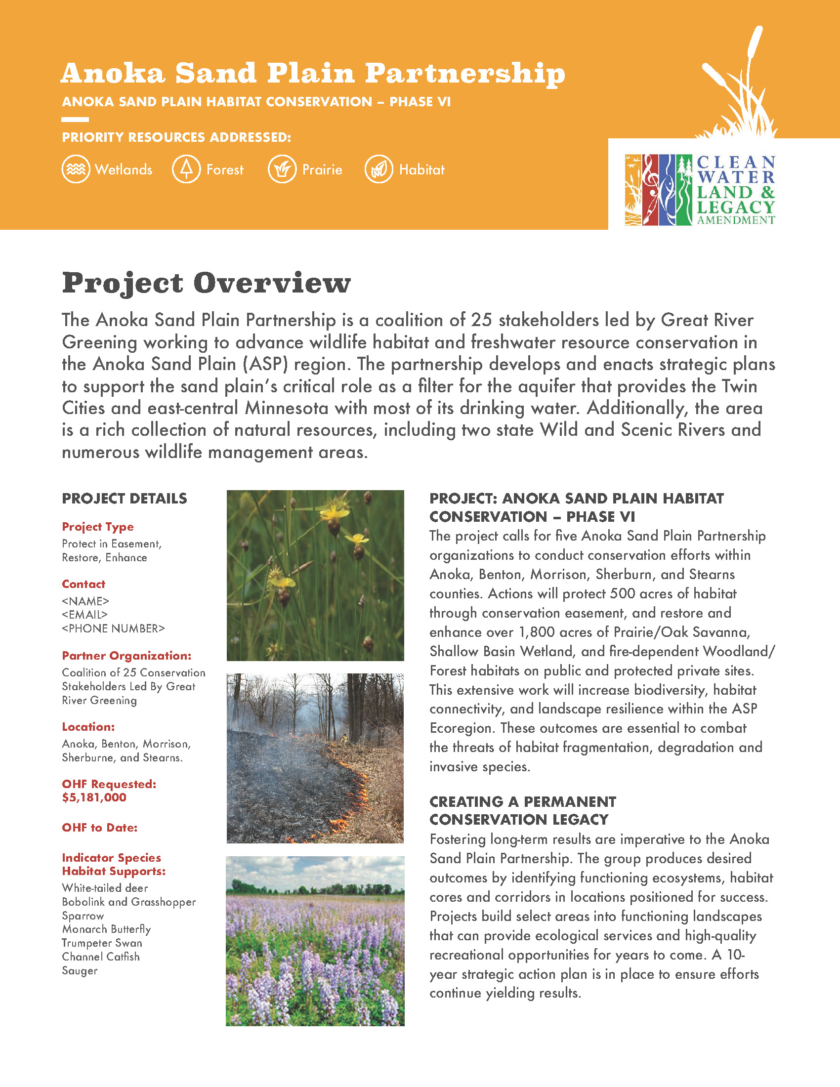
Project
profiles
• • • •

Slide 10

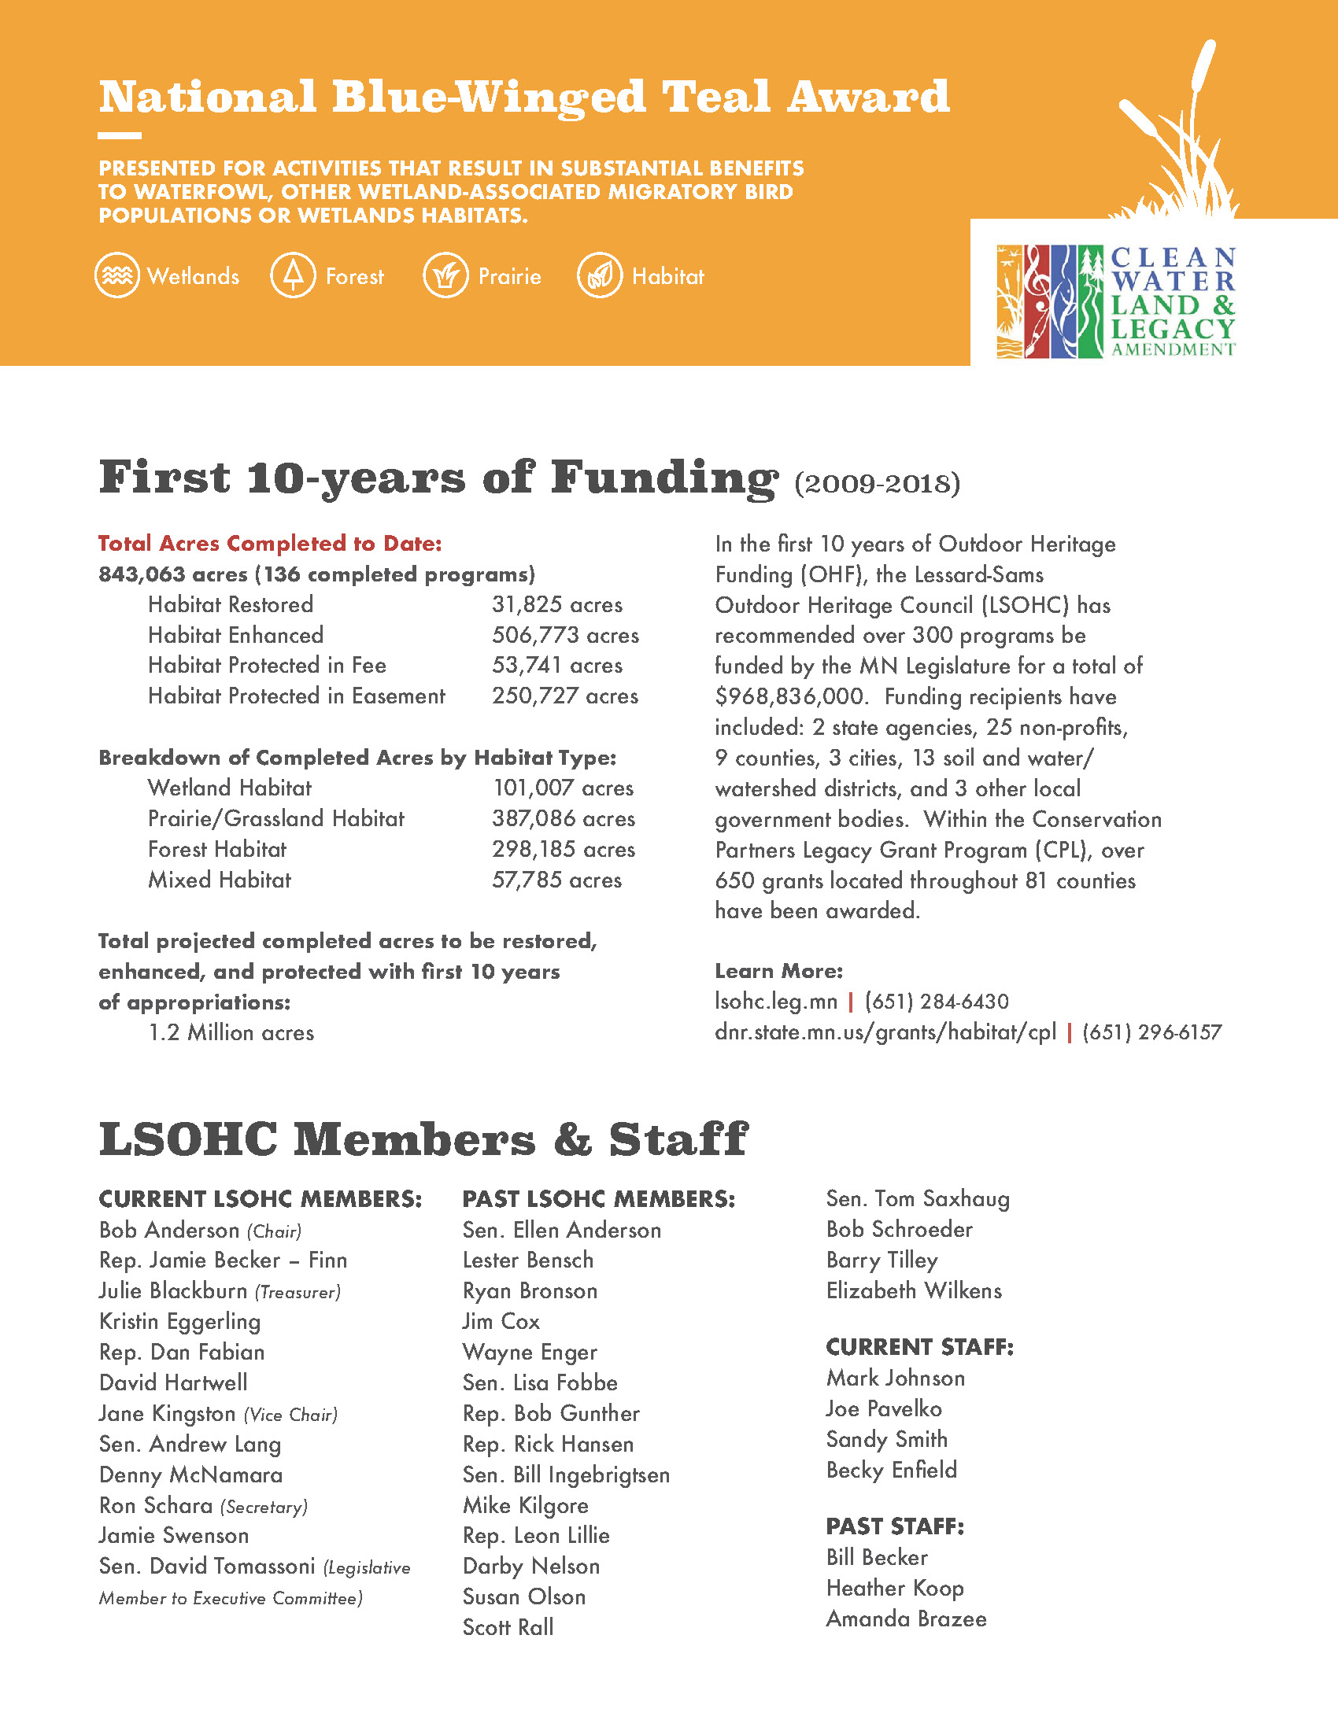
Blue-Winged
Teal Award
• • • •

Slide 11
Website Assessment

Slide 12
Objectives
• • • •
Assess technical functionality
Track and assess current search engine visibility
Establish comprehensive analytics system
Review website content
Assess and optimize website design

Slide 13
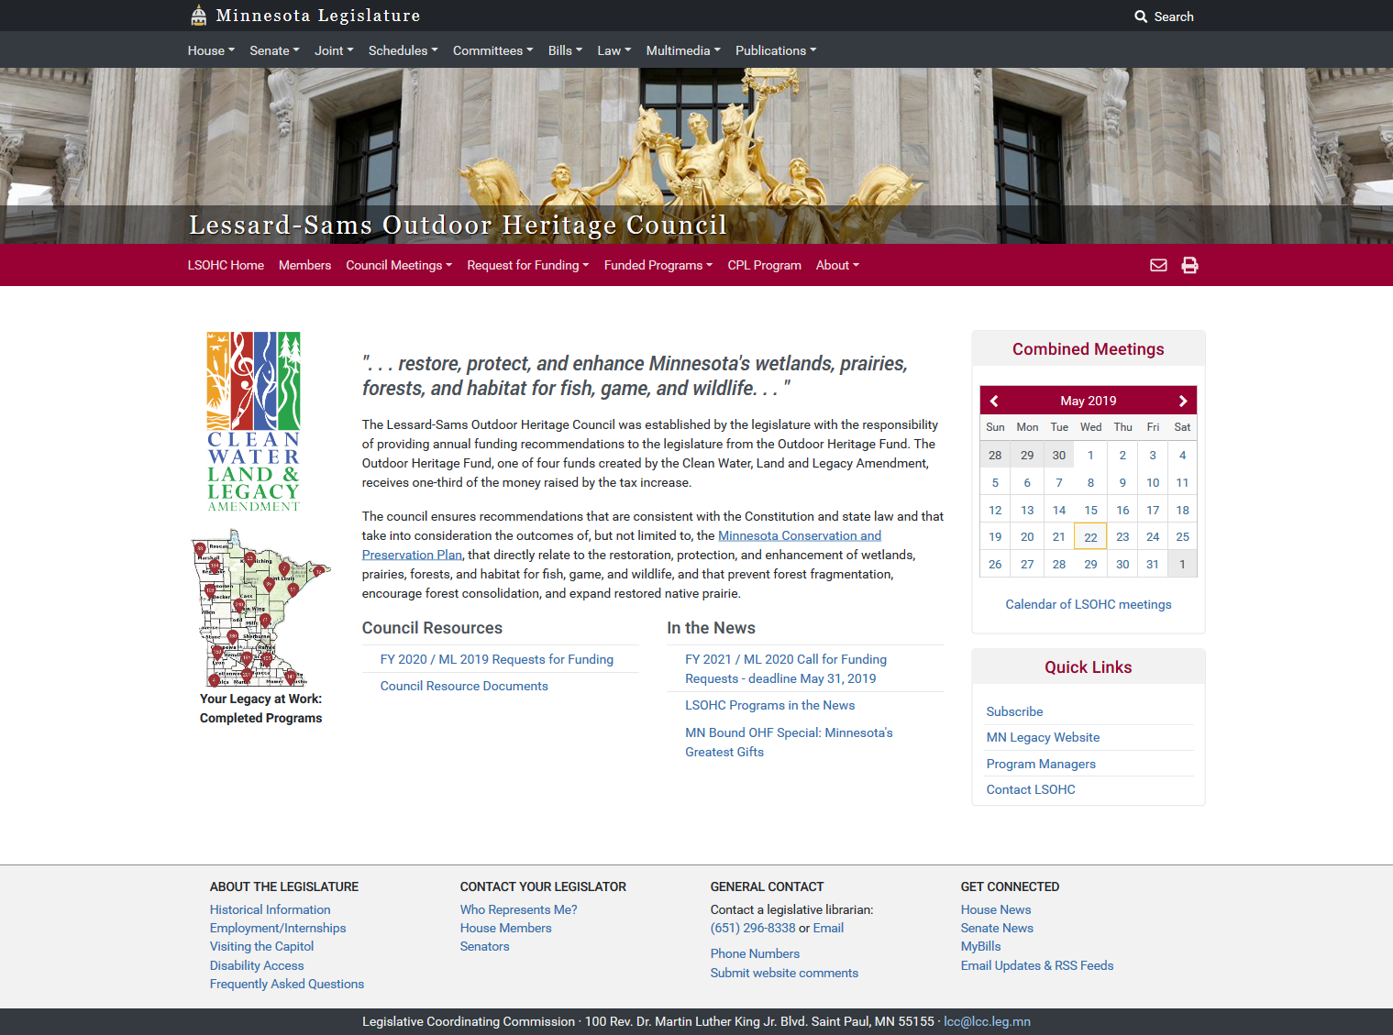
• • • •

Slide 14





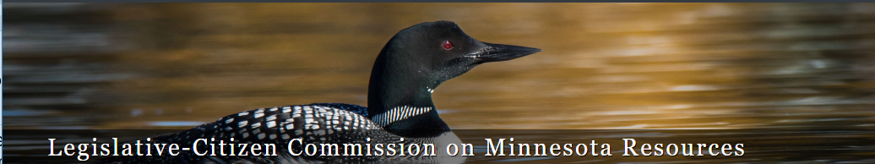
Online landscape
• • • •

Slide 15
Content and user experience (UX)
• • • •
Website organized in logical, hierarchical way
Features are typical to a contemporary government website experience
Website is mobile-responsive
Content is useful and concise, but readability and accessibility could be improved

Slide 16
Current content structure
• • • •

Slide 17
Conversion tracking / goal tracking
• • • •
Refine overall goals of website
What do we want people to do when they get there?
Use a contact form to encourage more submissions and effectively track
Set up call tracking to monitor and record phone calls made through the website

Slide 18
Key search phrases
• • • •
Tracking key search phrases:
  LSOHC
  Lessard-SAMS Outdoor Heritage Council
  Minnesota conservation
  Minnesota outdoors project funding
  Minnesota fishing issues
  Minnesota prairie issues
  Minnesota nature bill status
  Minnesota lakes projects

Slide 19
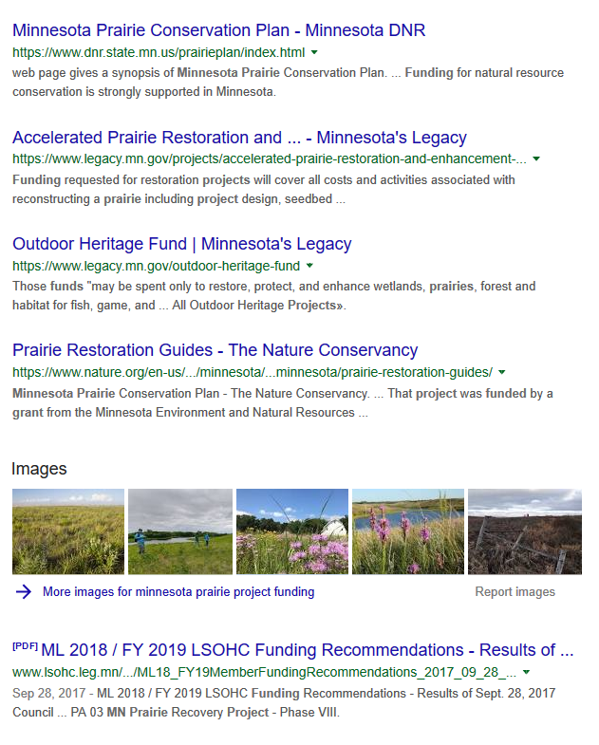
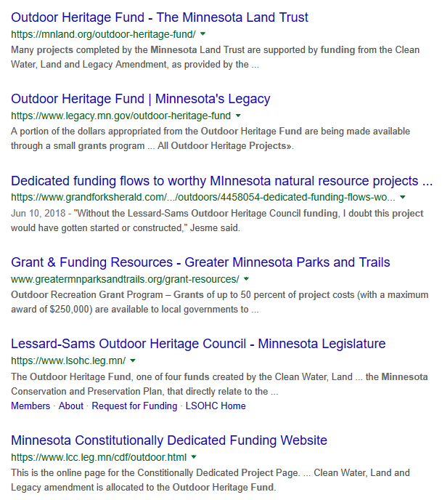
Examples of
LSOHC
in search
results
• • • •

Slide 20
SEO
• • • •
Significant opportunity to attract website visitors
Outreach and digital ad campaigns would help drive relevant traffic and increase public awareness
Consistent messaging will improve organic search rankings
“Restore, protect, enhance Minnesota’s wetlands, prairies, forests and habitat.”

Slide 21
Design impact
• • • •
Improve visual appeal of website
Add more imagery – photos and videos of OHF-funded projects and Minnesota’s landscape
Scrolling social media, short video clips on home page

Slide 22
Website traffic
• • • •

Slide 23
Progress
• • • •
+11%
Sessions
+9%
Visitors
+12%
New visitors
+8%
Visitors from organic search
+79%
Visitors from other websites

Slide 24
Website recommendations
• • • •
Re-evaluate goals and adjust tracking to measure successful visits
Update or remove old content
Conduct an ADA-compliance audit
Add seasonal photos / images
(fall, winter, spring, summer)

Slide 25
Project image organization
• • • •
Collect and organize project photos, videos and other related data
Significantly streamline and standardize the process, making assets easily available and shareable
Utilize existing assets whenever possible to save money
Use collected artwork in outreach materials and website design updates

Slide 26
Social Media

Slide 27
Early
progress
• • • •

Slide 28
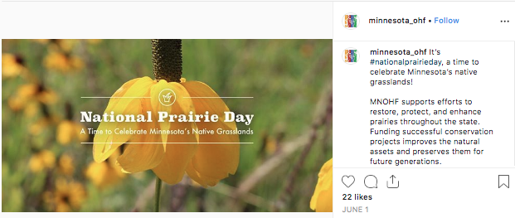
 | Followers 178 | Likes 367 | Engagements 377 | Engagement Per Media 10.77
Top Instagram Post

Slide 29
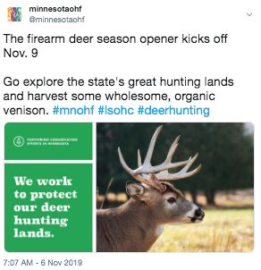
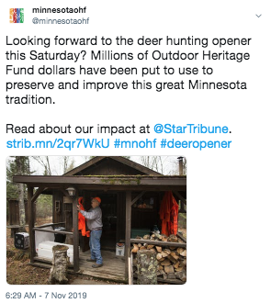
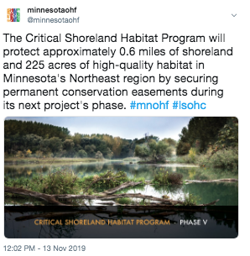
Twitter
• • • •
Twitter account launched in November
Content deployed in tandem with Facebook and Instagram

Slide 30
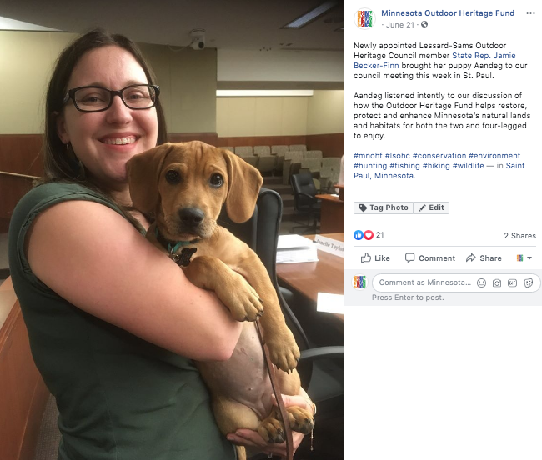
Social media
• • • •
More cute dog photos!

Slide 31
Public Relations

Slide 32
Media relations
• • • •
Press Releases
Distributed to date:
  FY2021 Funding Announcement
  Audubon Minnesota project
  Two Rivers Fish Passage project
  Call for Funding 2019
  Rep. Sondra Erikson meetings
  Cattail Spray Tour
Top Outlets
Have covered OHF/ LSOHC:
  Brainerd Dispatch
  Faribault Daily News
  States News Services
  StarTribune
  Echo Publishing
  MinnPost
  Grand Forks Herald
  Winona Post
  Northland Outdoors
  Independent Age
  St. Paul Pioneer Press
  MPR
  Winona
  Aitkin

Slide 33
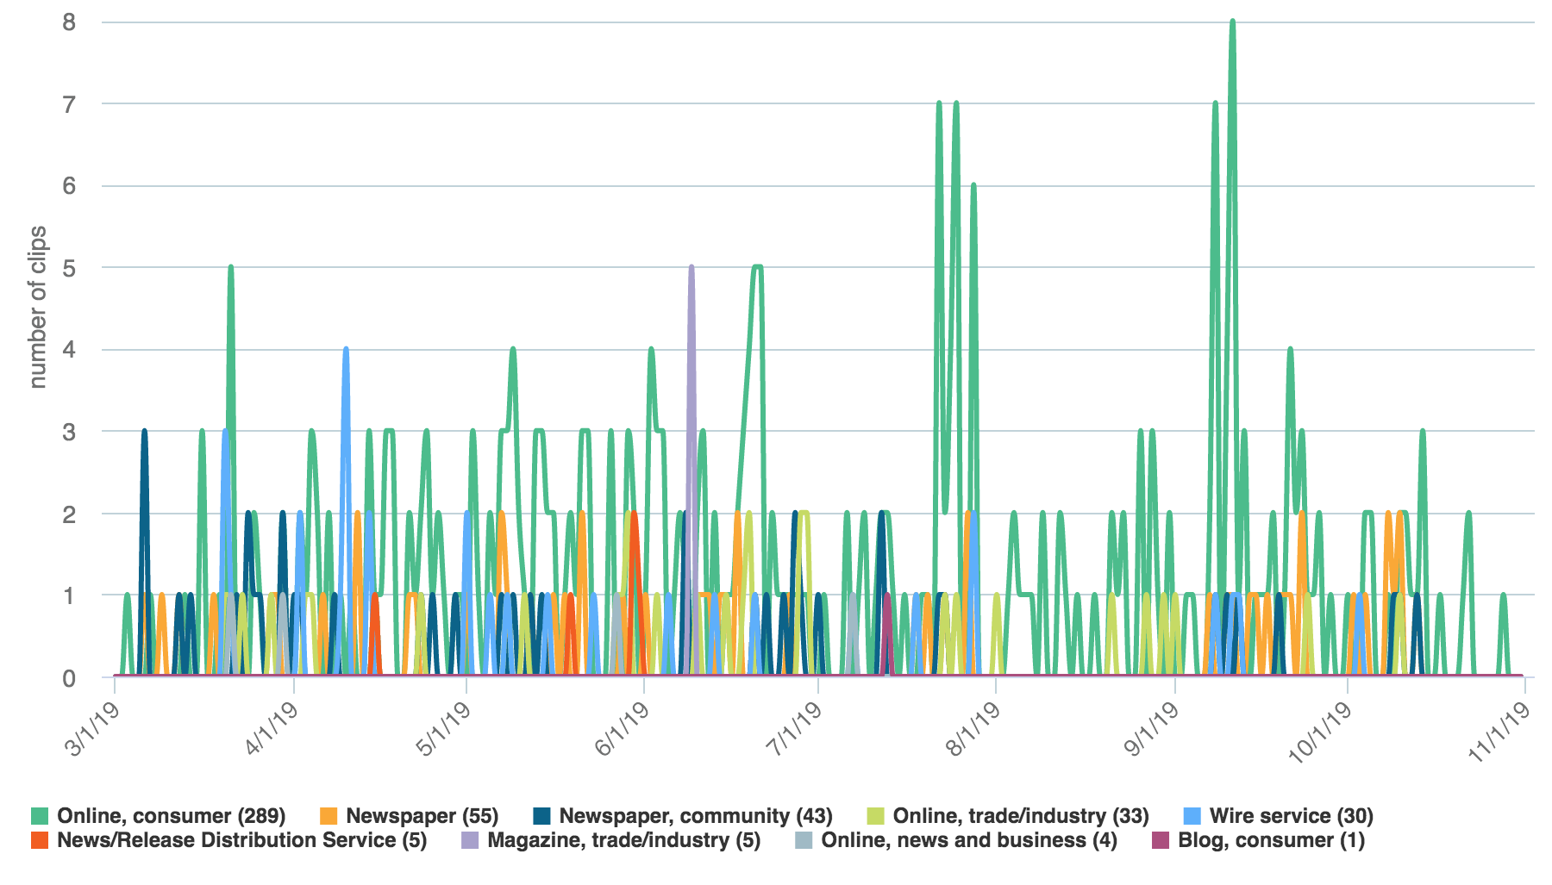
Trend of coverage

Slide 34
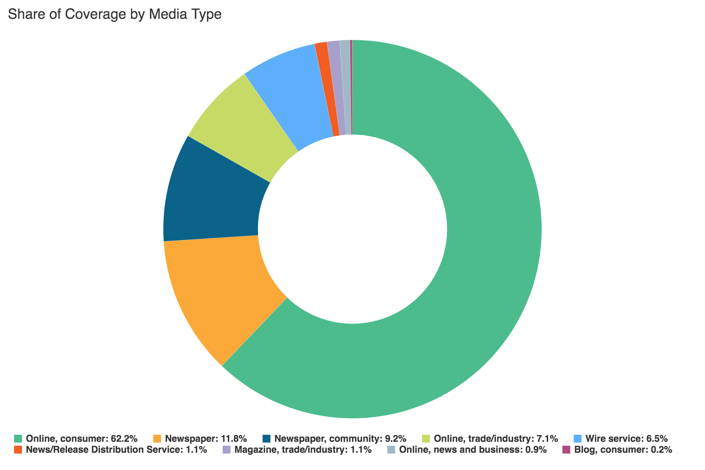
Share of coverage by media type
• • • •
Online consumer
Newspaper
Trade publication
Wire service
Magazine
Radio
Blog
TV

Slide 35
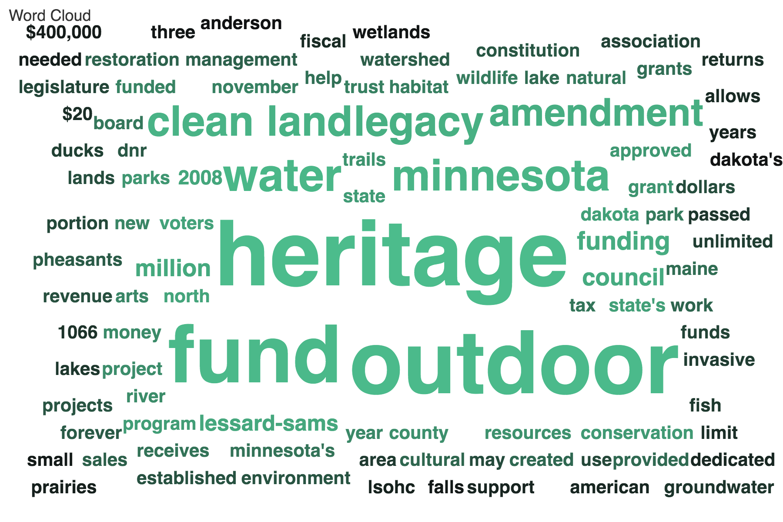

Slide 36
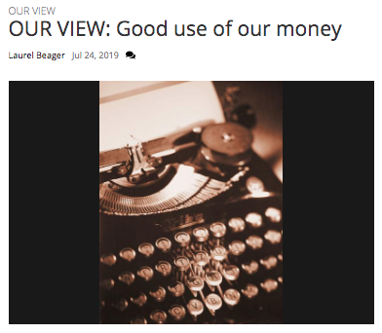
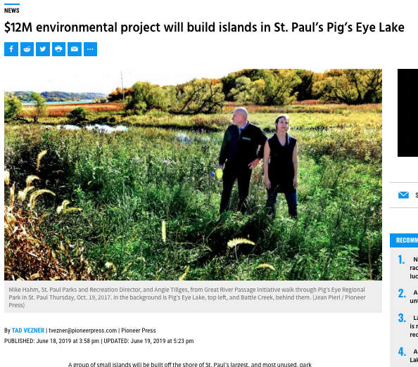

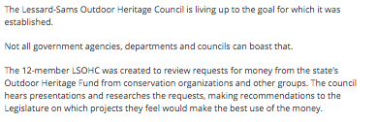
Top news coverage
• • • •
Audience Reach
3,200
International Falls Journal
Audience Reach
177,349
St. Paul Pioneer Press

Slide 37
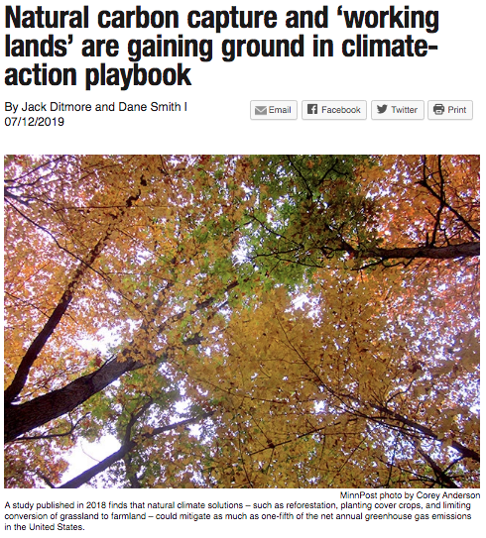
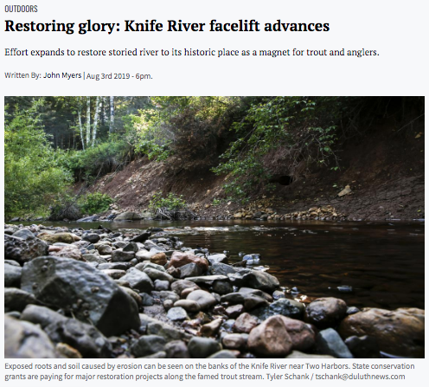
• • • •
Audience Reach
878,494
MinnPost
Audience Reach
21,107
Duluth News-Tribune

Slide 38
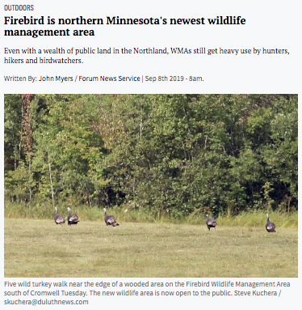
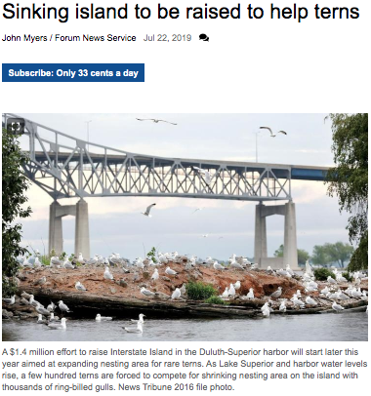
• • • •
Audience Reach
17,638
Grand Forks Herald
Audience Reach
30,177
Post-Bulletin

Slide 39
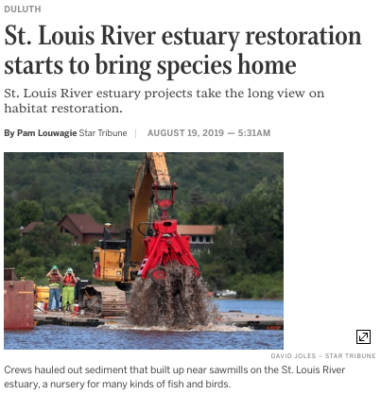
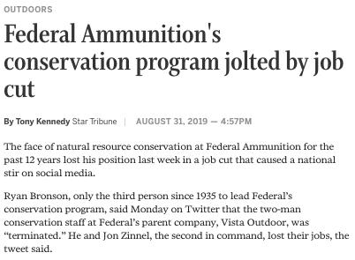
• • • •
Audience Reach
251,822
StarTribune
Audience Reach
251,822
StarTribune

Slide 40
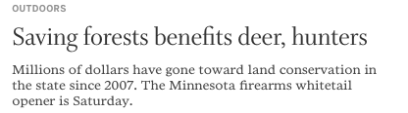
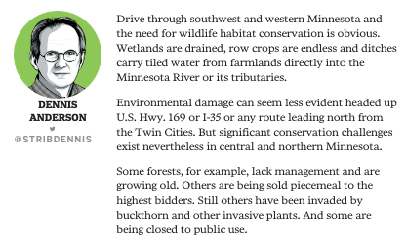
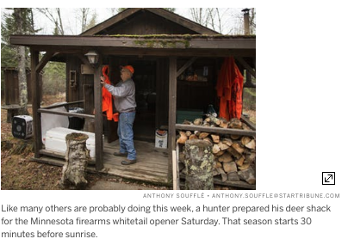
• • • •
Audience Reach
251,822
StarTribune

Slide 41
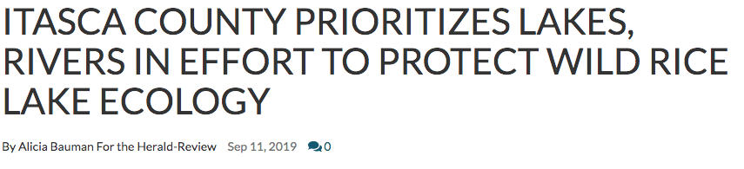
• • • •
Audience Reach
7,400
Herald Review

Slide 42
Next Steps

Slide 43
Further enhance outreach
• • • •
Continue public and media relations campaign
Organize public tours and events with partners, LSOHC board members and staff
Continue to educate journalists and other influencers on the funding process timeline
Leverage relationships with partner organizations to maximize outreach and audience

Slide 44
Production and distribution of videos
• • • •
Produce video(s) capturing the work of the Outdoor Heritage Fund for use in website, social media, newsletter and community meetings
Work with partners to use existing footage to save money
Video should answer the questions:
What is the fund?
What does it do?
Why is it important?

Slide 45
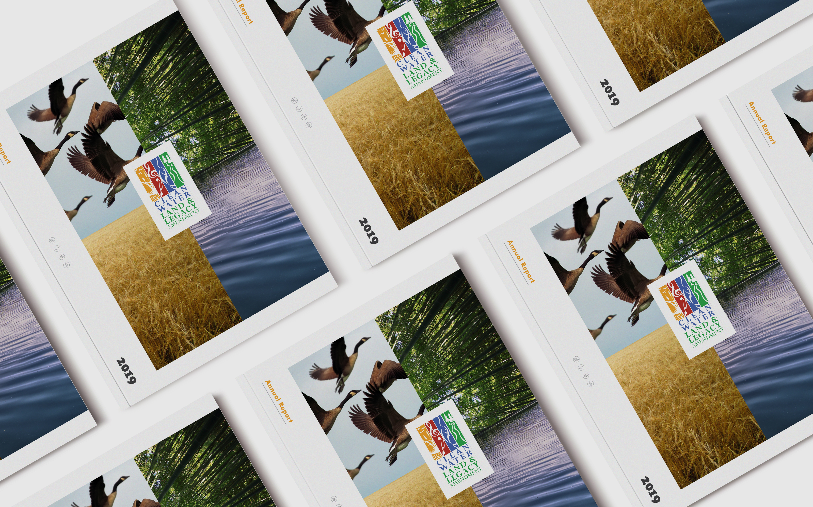
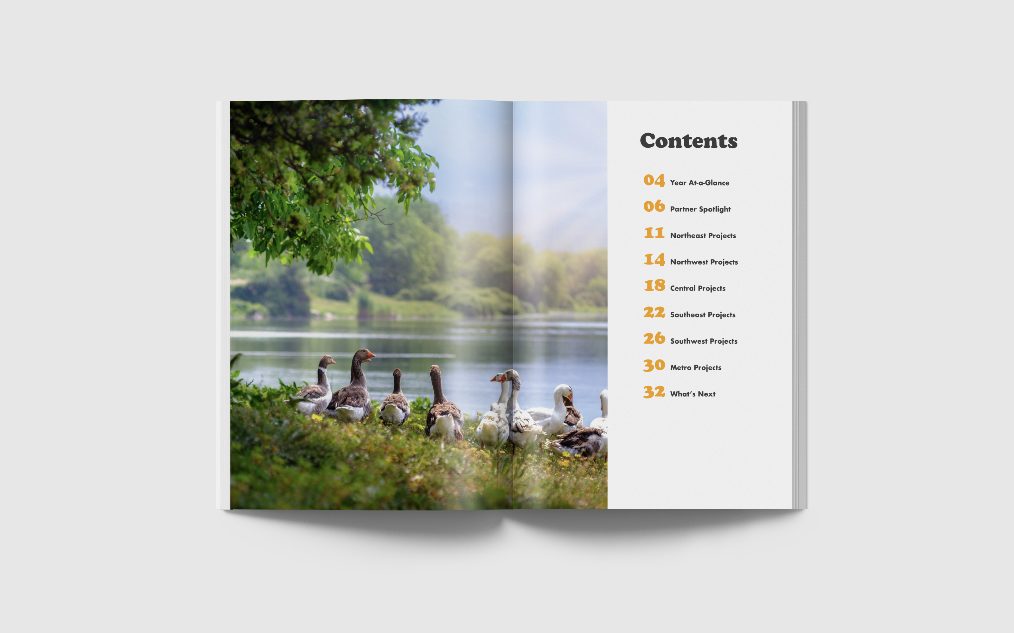
Creative assets
• • • •
Annual reports
Completed
project
spotlights
5-year recaps

Slide 46
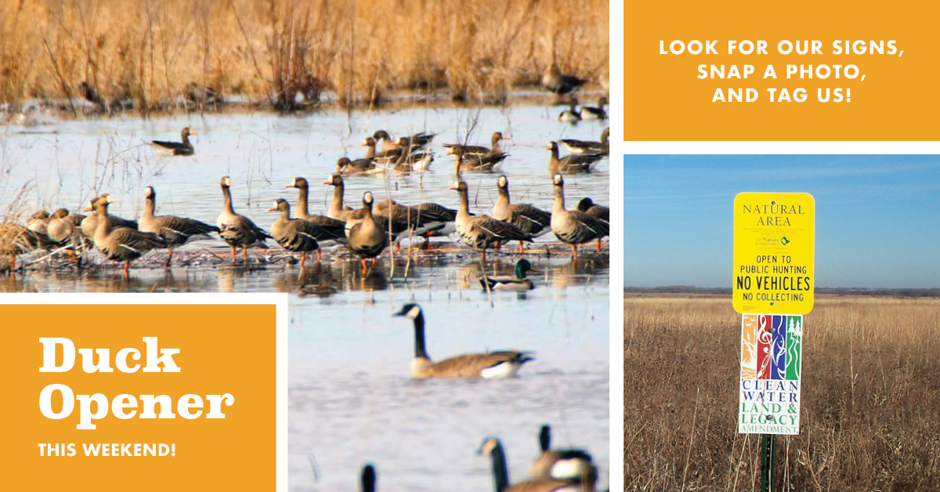
Photo and social
media contests
• • • •
Encourage people to share photos on social media enjoying OHF-funded projects
Capitalize on infrastructure and partnerships across the state

Slide 47
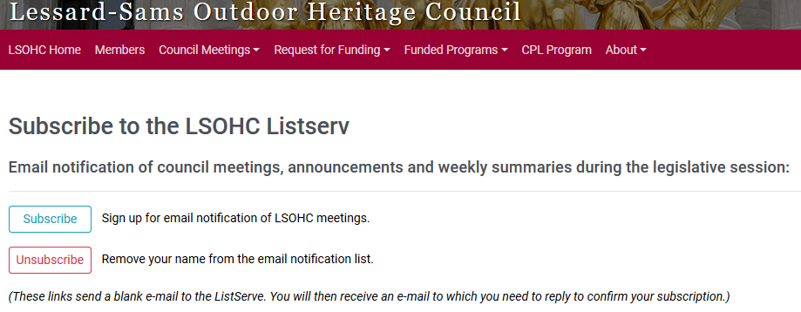
Electronic communications
• • • •
Utilize and expand existing email list
Offer engaging content to attract new subscribers

Slide 48
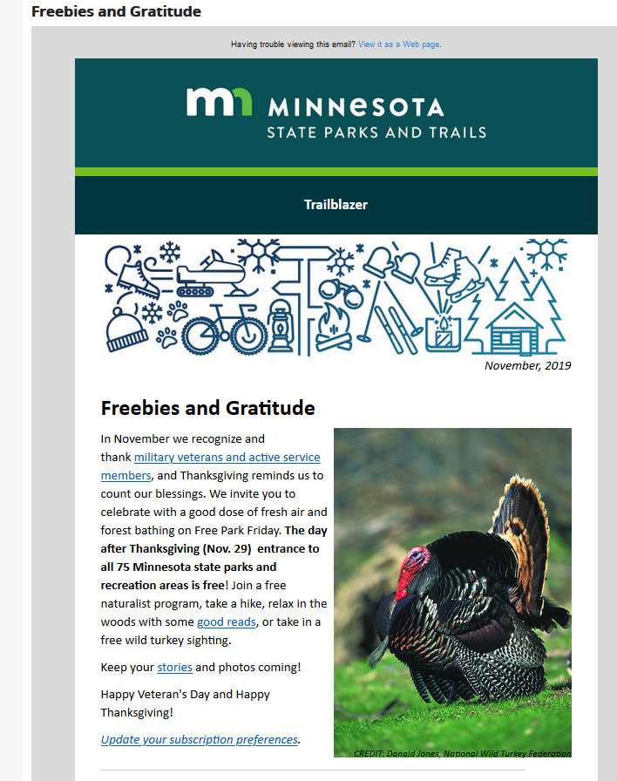
Newsletter
• • • •
Develop and distribute regular electronic newsletter on OHF highlights, accomplishments and partner features
Promote through website, social media and community engagement opportunities
Encourage Minnesotans to participate

Slide 49
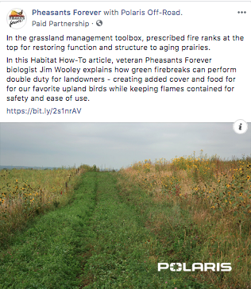
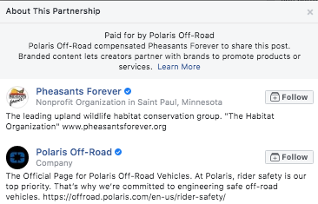
Sponsored social media
• • • •
Invest funds into sponsored social media to reach broader audience
Explore partnerships with like-minded businesses to leverage following

Slide 50
Questions?

